Slide 1
Prevalence of Hypertension and Its Association with Salt Intake among Individuals Aged 40 Years and above in Northern Part of Bangladesh: a Cross-Sectional Study
Course Name: Research Methodology (PBH: 712.2)
Course Faculty: Professor Azaz Bin Sharif
Submitted by: Group One
August 22, 2025

Slide 2
Group Members
Md. Abdul Mannan (2517624080)
Nafis Safwat (2517437080)
Mirza Jannatul Ferdous (2517436080)
Syeda Tanzim Tashfia (2517675080)
Masuka Akther (2517512680)
Md. Yeasir Arafat (2517101680)
Md. Tarek Hasan (2517605080)

Slide 3
Introduction
Hypertension, or high blood pressure, is a major public health concern worldwide, increasing the risk of cardiovascular disease, stroke, and kidney disease.
Global and national burden: Hypertension affects 1.3 billion people worldwide, doubling since 1990 [WHO, 2023]. In Bangladesh, prevalence is around 20% among adults, with studies reporting a wide range from 1.1% to 75% [Islam et al., 2021].
Salt intake as a key risk factor: The WHO recommends <5 g/day, but South Asian populations consume nearly 9.7 g/day on average [PAHO, 2021; Shaheen et al., 2021]. High salt intake is a major modifiable contributor to hypertension.
Bangladesh context: Average salt intake among Bangladeshis is 9–10 g/day, almost double the WHO guideline [Rahman et al., 2017; TBS News, 2023]. An urban Dhaka study reported 8.9 g/day (95% CI: 8.6–9.3 g) [Hossain et al., 2023], highlighting the need for research on its association with hypertension.

Slide 4
Justification of the study
High-risk age group: Studying this age group (40 years and above ) allows identification of early trends and risk factors in a population that is particularly susceptible.
Local evidence gap: Although excessive salt intake is a well-established contributor to hypertension, limited context-specific evidence exists in Bangladesh for older adults. In particular, culturally ingrained habits like adding extra salt during cooking or at the table have not been adequately quantified or linked with hypertension in this demographic.
Public health relevance and study design: The findings will provide baseline data to inform age-appropriate interventions, community programs, and educational campaigns, helping to reduce extra salt consumption and prevent hypertension-related complications.

Slide 5
Research question
Is there any significant association between extra salt intake and the prevalence of hypertension among individuals aged 40 and above, after controlling for key confounding factors such as age, sex, BMI, and physical activity?

Slide 6
Objectives
General Objective:
To determine the association between extra salt intake and the prevalence of hypertension among individuals above 40 years of age in Nilfamary and Panchagarh regions.
Specific Objectives:
To estimate the prevalence of hypertension among individuals aged 40 years and above in the study population
To assess the unadjusted association between extra salt intake and the prevalence of hypertension
To determine the association between extra salt intake and hypertension after controlling for potential confounding variables, including age, sex, BMI, and physical activity

Slide 7
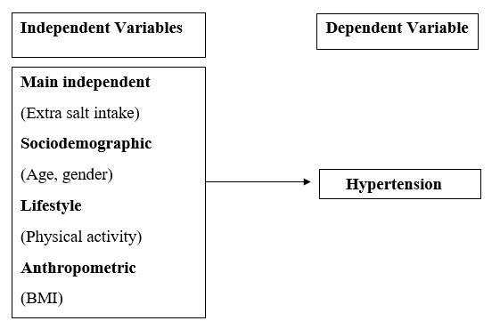
Conceptual framework

Slide 8
Research methodology
Study Design
Cross-sectional study
Study Population
Adults aged 40 years or above
Study Site & Area
Nilphamary and Panchagar Regions
Study Period
9 months (September 2025 to May 2026)

Slide 9
Research methodology (cont.)
Inclusion criteria
Age 40 years and above
Residing within the study site for at least 6 months
Willing and able to provide informed consent
Exclusion criteria
Pregnant women
Patients on dialysis or with chronic kidney disease
Individuals with an acute or severe illness that prevents participation in the study procedure

Slide 10
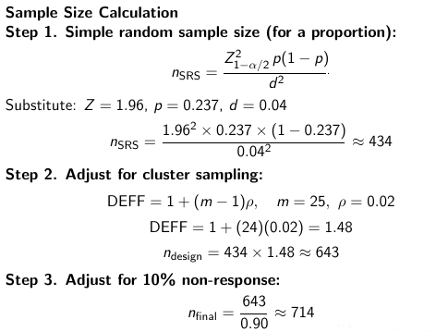
Research methodology (cont.)

Slide 11
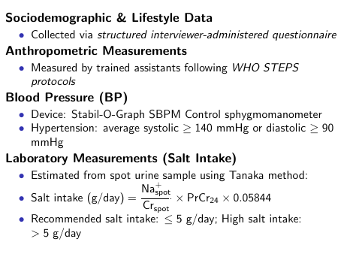
Research methodology (cont.)

Slide 12
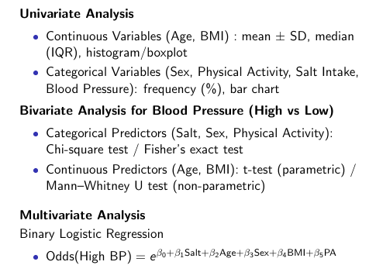
Research methodology (cont.)

Slide 13
Research methodology (cont.)
Ethical Considerations
Prior to data collection, ethical approval will be obtained from the Institutional Review Board (IRB) of North South University.
All study procedures will comply with the university's ethical standards and national research ethics guidelines.

Slide 14
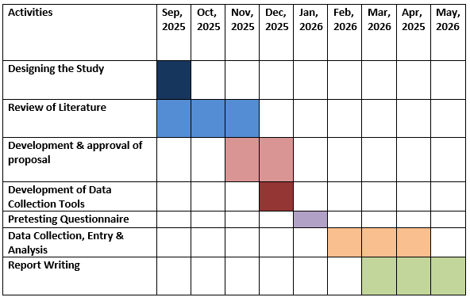
Timeline

Slide 15
Thank you

